Slide 1
Predicting Household Food Insecurity
in Kenya
An early-warning screening tool to help humanitarian responders reach the most
food-insecure households ahead of the forecast 2026 El Niño rains
Presented by
PRISCILLA W KUNG’U
Ngao Labs Cohort 3 · Group 10 · FDSAI Capstone Project
Priscilla Kungu | github.com/PriscillaKungu/Ngao-Labs-Cohort-3-Group-10-Food-Security-Screening-Model
IPC-STYLE 5-PHASE SEVERITY SCALE

Slide 2
Why This Matters Now
A Historically Strong El Niño Is Already Forming
Forecasters place the current event among the strongest on record with impacts expected to reverberate through 2027.
274M
81%
18M+
$1 → $7
people forecast acutely food insecure across 45 countries by end of 2027 49M more than today(WFP)
probability Kenya’s 2026 El Niño develops into a very strong event (KMD / WMO)
more people at risk of worsening food insecurity across East and Southern Africa, up over one-quarter
return on every dollar spent on anticipatory action instead of post-disaster response (FAO)
“El Niño is a massive threat to the food security of millions who are already vulnerable. Severe floods and droughts can quickly push communities from coping to crisis.”
Carl Skau, WFP Acting Executive Director, August 2026
Ngao Labs Capstone · Group 10 — Food Security Screening
2

Slide 3
National Risk Assessment
Kenya Has Already Mapped Its Highest-Risk Counties
Kenya’s National Disaster Operations Centre (NDOC) has identified county-level exposure across four regions, plus three major urban centres.
Coast
Lake Basin
Rift Valley
North Eastern
Tana River, Kilifi, Lamu, Mombasa, Kwale
Flooding, storm surge, coastal erosion
Kisumu, Busia, Siaya, Homa Bay, Migori
Flooding, landslides, disease outbreaks, displacement
Turkana, Baringo, West Pokot, Narok
Drought AND flash floods/landslides; livestock losses
Garissa, Wajir, Mandera
Chronic drought, water shortage, livestock losses
Also flagged: Nairobi, Mombasa and Kisumu as high-risk urban centres, where poor drainage and strained infrastructure could turn heavy rainfall into a humanitarian emergency. Kenya's last severe episode (1997–98) displaced thousands; 2015–16 and 2023–24 events each caused major loss of life and damage.
Ngao Labs Capstone · Group 10 — Food Security Screening
3

Slide 4
The Gap This Project Addresses
Forecasts Tell Us Where. They Don't Tell Us Who.
NDOC's risk map identifies vulnerable counties. It cannot tell a caseworker which specific household, among thousands, needs help first when a flood or drought hits.
Regional risk maps
County-level, static, updated periodically
Household screening (this project)
Individual-level, uses live household data, ranks by predicted severity
A model trained on real household survey data can flag the individual families most likely to be severely food insecure, inside a risk county or outside it, before an NGO or government team even arrives on the ground.
Ngao Labs Capstone · Group 10 — Food Security Screening
4

Slide 5
Capstone Problem Statement
What This Model Predicts, For Whom, and How
Target variable
A 4-class household food security status: food secure, mildly, moderately, or severely insecure. It is built from a standards-based (HFIAS/CARI-style) severity score
Population
Kenyan households, reachable by phone, surveyed in the Wave 4 Kenya COVID-19 Rapid Response Phone Survey (World Bank / KNBS / UNHCR)
Features used
~68 household characteristics: assets, housing materials, employment, farming, expenditure, transfers, health access, and county
Primary metric
Macro F1 (treats all four severity classes equally which is critical given class imbalance), reported alongside weighted F1 and a majority-class baseline
Ngao Labs Capstone · Group 10 — Food Security Screening
5
Notes:
The HFIAS (Household Food Insecurity Access Scale) and CARI (Consolidated Approach for Reporting Indicators of Food Security) are standardized survey tools used to measure and classify household food insecurity. HFIAS focuses on psychological and behavioral access, while CARI combines multiple metrics into a unified classification scale.
HFIAS (Household Food Insecurity Access Scale): A 9-question tool measuring a household's anxiety, uncertainty, and behavioral changes regarding food access over a 30-day recall period, scoring severity from 0 to 27
CARI (Consolidated Approach for Reporting Indicators of Food Security): Developed by the World Food Programme, this composite method classifies households into four distinct security categories (food secure, marginally, moderately, or severely insecure) using metrics like food consumption and coping strategies

Slide 6
Data And Method
Dataset and Modelling Approach
Dataset
Method
Kenya COVID-19 Rapid Response Phone Survey, Wave 4 (World Bank / KNBS / UNHCR)
4,894 households nationally, phone-survey based
47 counties, urban and rural strata
Independently validated: this project's target correlates with the survey’s separate Household Hunger Scale (HHS): a monotonic, cross-checked signal
Baseline: majority-class prediction (always “food secure”)
Candidates compared: XGBoost (default, class-balanced), XGBoost (RandomizedSearchCV-tuned), CatBoost (native categoricals)
Class imbalance handled via sample weighting, not oversampling
Leakage-safe county target encoding computed only on the training fold
Selection metric: macro F1 on a held-out test set (979 households)
Ngao Labs Capstone · Group 10 — Food Security Screening
6

Slide 7
Target Variable
A Standards-Based, 4-Class Food Security Score
Built from the survey’s food-worry, hunger, and meal-skipping questions into a severity score, then bucketed following HFIAS/CARI conventions.
Food Secure
Mildly Insecure
Moderately Insecure
Severely Insecure
score = 0
score = 1
score 2–3
score > 3
Why bucket it this way
Independently validated
Mirrors the internationally recognised HFIAS/CARI approach used by FAO and WFP food-security classifications
Keeps the model’s output interpretable to non-technical stakeholders: a caseworker can act on “severely insecure” without needing to know the underlying score
This target correlates with the survey's separate Household Hunger Scale (HHS) question set
Mean HHS score rises monotonically across the four buckets: a cross-checked signal, not a single noisy question
Ngao Labs Capstone · Group 10 — Food Security Screening
7
Notes:
The HFIAS (Household Food Insecurity Access Scale) and CARI (Consolidated Approach for Reporting Indicators of Food Security) are standardized survey tools used to measure and classify household food insecurity. HFIAS focuses on psychological and behavioral access, while CARI combines multiple metrics into a unified classification scale.
HFIAS (Household Food Insecurity Access Scale): A 9-question tool measuring a household's anxiety, uncertainty, and behavioral changes regarding food access over a 30-day recall period, scoring severity from 0 to 27
CARI (Consolidated Approach for Reporting Indicators of Food Security): Developed by the World Food Programme, this composite method classifies households into four distinct security categories (food secure, marginally, moderately, or severely insecure) using metrics like food consumption and coping strategies
The Household Hunger Scale (HHS) is a simple metric used to measure severe food deprivation in a household over the past 30 days. Developed by the FANTA Project, it uses three specific questions about going without food, sleeping hungry, or going a full day and night without eating.
FANTA: Food and Nutrition Technical Assistance
Core Questions and Recall
The HHS asks about three severe conditions experienced due to a lack of resources over the preceding 30 days:
No food in the house of any kind.
Any household member went to sleep hungry.
Any household member went a whole day and night without eating.

Slide 8
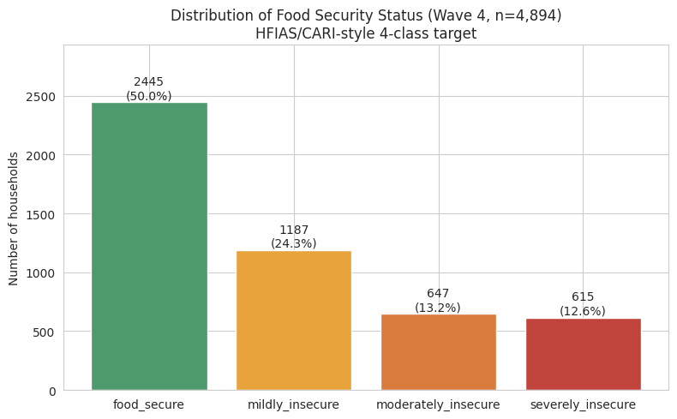
Exploratory Finding
Class Imbalance Shapes Every Decision After This
Why this matters
Half of all households are food secure, a naive model could hit 50% accuracy by predicting one class every time
The three insecure classes are each minorities (12–24%)
Accuracy alone would hide poor performance on exactly the households a targeting tool exists to find
We use macro F1 as the primary metric and class-balanced sample weighting during training to counteract this
Ngao Labs Capstone · Group 10 — Food Security Screening
8

Slide 9
Baseline Rule
Every Model Must Beat Doing Nothing
The baseline: always predict the majority class (“food secure”) for every household.
0.333
0.167
979
Baseline Weighted F1
Baseline Macro F1
Held-out test households
(20% split, stratified)
A macro F1 of 0.167 is the floor a model that has “learned nothing about minority classes” would score.
Any real value from this project has to show up as improvement over these two numbers.
Ngao Labs Capstone · Group 10 — Food Security Screening
9

Slide 10
Model Selection
Three Candidates, One Held-Out Comparison
Model | Weighted F1 | Macro F1
XGBoost -default + class-balanced weights | 0.538 | 0.454
XGBoost -tuned (RandomizedSearchCV) | 0.531 | 0.451
CatBoost -native categorical handling | 0.518 | 0.446
Selected: XGBoost with default hyperparameters + class-balanced sample weights.
It scored highest on macro F1, the primary metric, and hyperparameter tuning did not meaningfully improve on the defaults.
Ngao Labs Capstone · Group 10 — Food Security Screening
10

Slide 11
Headline Results
Model vs. Baseline
Weighted F1
Macro F1
Accuracy
0.333
0.167
50.0%
→
→
→
0.538
0.454
52.2%
+0.205
+0.287
+2.0 pp
Honest framing:
macro F1 nearly tripled over baseline, which means the model has genuinely learned to distinguish the minority insecure classes not just the majority class. But 52% accuracy on a 4-class problem is a working prototype, not a finished decision-maker. It should rank and prioritise households for follow-up, not replace a caseworker's judgement.
Ngao Labs Capstone · Group 10 — Food Security Screening
11

Slide 12
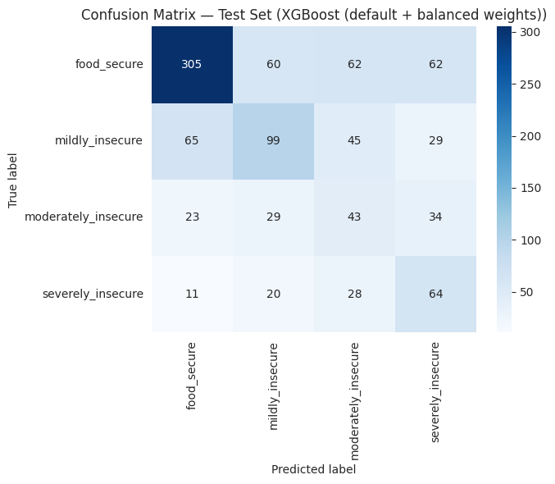
Error Analysis
Where the Model Gets It Wrong and Why It Matters
The costly error direction
20.2% of genuinely insecure households were misclassified as food secure
In an assistance-targeting context, this is the more damaging error: a household that needs help is not flagged for it
Pattern in the errors
Errors concentrate along the diagonal neighbours (adjacent severity classes), not scattered randomly:
Most errors are one category off, but a substantial share jump two categories, 62 truly food-secure households were predicted severely insecure, more than the 34 moderate→severe misses.
Moderately-insecure is the weakest class (F1 = 0.28): the hardest boundary to draw
Ngao Labs Capstone · Group 10 — Food Security Screening
12

Slide 13
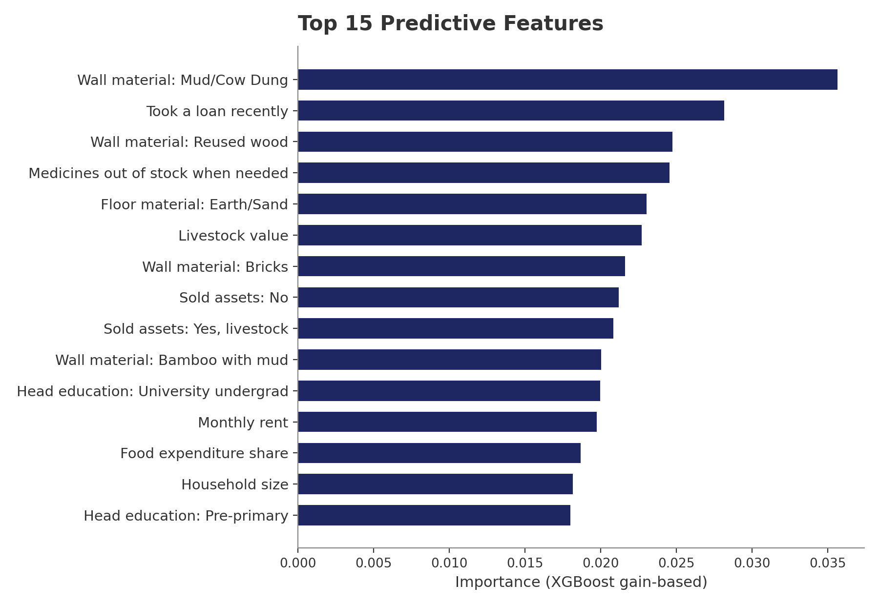
Model Interpretation
What Actually Drives the Model’s Predictions
Reading the signal
Housing materials (wall/floor type) dominate, a durable, low-cost proxy for structural poverty
Distress-coping behaviours matter: took a loan, sold assets, medicines out of stock
Livestock value and food expenditure share both carry real economic signal
This lines up with the World Bank's own Kenya COVID-19 RRPS finding that dirt-floor households are 9pp more likely to go hungry
Ngao Labs Capstone · Group 10 — Food Security Screening
13

Slide 14
Fairness Evaluation
The Model Performs Worse for Rural Households
Subgroup | N (test) | Weighted F1 | Macro F1
Urban | 523 | 0.563 | 0.469
Rural | 456 | 0.507 | 0.436
Why this gap is a fairness concern
Rural households are already documented as more food insecure nationally. World Bank RRPS finds 48% of rural households went hungry vs 34% urban
A model with lower recall precisely where insecurity is worse compounds an existing gap rather than correcting for it
El Niño’s rural-heavy risk counties (drought, livestock loss) make this gap operationally and statistically significant
Fairness criterion applied: Equal Opportunity — among truly severely-insecure households, the model should identify an equal share regardless of urban/rural status. By this standard it currently falls short (58.1% urban vs 45.9% rural severe-class recall).
Ngao Labs Capstone · Group 10 — Food Security Screening
14

Slide 15
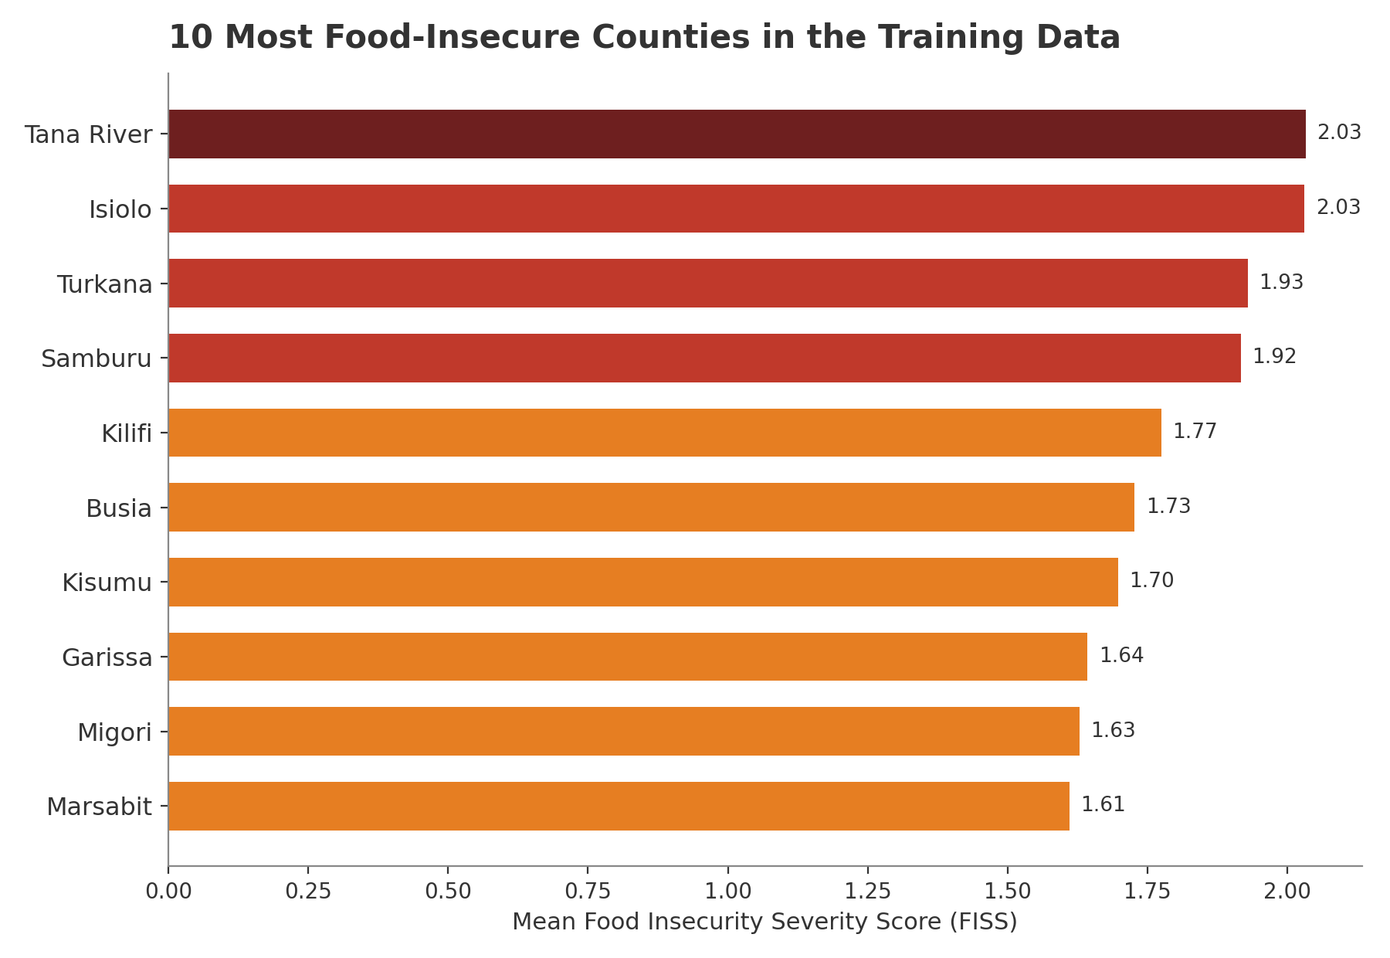
Key Finding
The Most Food-Insecure Counties Are the El Niño Risk Counties
7 of 10 also on NDOC's list
Tana River, Turkana, Kilifi, Busia, Kisumu, Garissa and Migori all independently appear on Kenya’s official El Niño high-risk county list
This model was trained on 2020-21 COVID-shock data, yet it converges with an unrelated 2026 climate-risk assessment
This convergence is not proof the model is causally correct but it is a strong external signal that structural poverty markers (housing, assets, livelihoods) predict the same households at risk from economic shocks and climate shocks alike.
Ngao Labs Capstone · Group 10 — Food Security Screening
15

Slide 16
Engineering
From Notebook to a Live Screening Tool
1
→
2
→
3
→
4
Train and Serialize
FastAPI Backend
Deploy on Render
Caseworker Form
XGBoost model, encoders, and county rate map bundled into a single artifact (pickle)
preprocess_new_household() mirrors the notebook’s feature engineering exactly, for one household or a bulk CSV
Python 3.12 web service, auto-deployed from GitHub on every commit
All ~68 model inputs exposed as a plain-language web form, with dropdowns matched to real survey codes
Live tool: food-security-screening-capstone-project.onrender.com
Source: github.com/PriscillaKungu/Ngao-Labs-Cohort-3-Group-10-Food-Security-Screening-Model
Ngao Labs Capstone · Group 10 — Food Security Screening
16

Slide 17
Product Walkthrough
Two Ways Caseworkers Use the Tool
Single Household Form
Bulk CSV Screening
Household basics, employment, housing, dependents, farming, assets, expenditure, transfers, and health- organised into clear sections
Dropdowns use real, human-readable labels (e.g. county names, education levels) mapped to the exact codes the model was trained on
Returns a predicted status (secure → severely insecure) with a confidence score, instantly
Caseworkers upload a CSV of many households at once - one row per household
The tool returns the same CSV with predicted_status and confidence columns added
Rows are automatically sorted so the most food-insecure households appear first which is a ready-made targeting list for field teams
Ngao Labs Capstone · Group 10 — Food Security Screening
17

Slide 18
Why This Matters
Turning a Household Survey Into a Targeting List
Anticipatory action works only if aid reaches the right households before the shock peaks. This tool shortens the distance between a household's raw data and an actionable priority list.
Screen
Rank
Prioritise
Cushion the shock
Field or phone-collected household data enters the tool either as one record or thousands
Households are sorted by predicted severity, most insecure first
Caseworkers and county officials direct limited aid, cash transfers, or follow-up visits to the top of the list
Households facing El Niño floods or drought get support before assets are sold or children are pulled from school
Every $1 invested in anticipatory action can generate up to $7 in avoided losses (FAO). A faster, data-driven targeting step is a direct contribution to that return.
Ngao Labs Capstone · Group 10 — Food Security Screening
18
Notes:
Current government plans include a National El-Nino Contingency Plan that includes farmers advisory, flood mitigation works, reinforcement of transport infrastructure, emergency resource pre-positioning, and coordinated disaster response.

Slide 19
Responsible AI Statement · 1 Of 2
Who This System Affects, and What Could Go Wrong
Who is affected
Worst possible outcome
Users: caseworkers and programme staff who view outputs and act on them
Decision subjects: individual Kenyan households classified by the model, most of whom will never know it was applied to their data
Voiceless affected parties: households with no phone access, structurally invisible to a phone-survey-derived dataset and therefore to this model
A severely insecure rural household is missed and excluded from a prioritisation list during a resource-constrained response since recall is measurably lower for rural (45.9%) than urban (58.1%) households
Equally concrete: 62 of 489 genuinely food-secure households were flagged as severely insecure in testing nearly as many as the 64 severe cases correctly caught diverting scarce aid
Ngao Labs Capstone · Group 10 — Food Security Screening
19

Slide 20
Responsible AI Statement · 2 Of 2
Cost, Redress, Monitoring and What's Next
Who bears the cost
Almost entirely the households being classified, not the organisation deploying the model; errors should be monitored through effects on the people scored, not aggregate accuracy alone
Redress
None exists today given this is a research prototype. If deployed, any household excluded from aid on this model’s basis should have the right to a human follow-up visit within 14 days; county staff retain final authority on eligibility not the model
Monitoring
Trained on 2020–21 COVID-shock data. Re-evaluate macro F1 and the urban/rural gap against newer data before any real use; retrain or withdraw if macro F1 falls below 0.40 or the recall gap widens past 12 points
Three findings.
1) Housing and coping-behaviour features, not just income, drive predictions. 2) The model's highest-risk counties independently match Kenya's official El Niño risk map. 3) A rural performance gap must close before this tool is fair to deploy for targeting.
Next step: partner with a county or NGO to pilot the bulk-screening workflow on live pre-positioning data ahead of the September 2026 El Niño peak.
Ngao Labs Capstone · Group 10 — Food Security Screening
20

Slide 21
Thank you
Questions and discussion
Group 10 • Foundations of Data Science & AI • Ngao Labs Program

